Slide 1

Introduction to the Simplest Systematics, overlaps and silences

Slide 2
After this lecture you will …
Practise
Practise identifying backchannels and explaining what role they play in turn-taking
Identify
Identify turn constructional units and their role in turn-taking
Distinguish
Distinguish between self-selection and other-selection
Explain
Explain how turn construction and allocation come together in the simplest systematics
Discuss
Discuss how different overlaps occur in conversation
Discuss
Discuss how silences occur in conversation

Slide 3
‘Hidden rules’ of conversation (again)
As we mentioned in section, we want to know what ‘hidden rules’ people follow to determine:
When to speak
Who should be speaking
… in order to reach the ‘no gaps, no overlaps’ ideal.
The Simplest Systematics (Clift Ch. 4) provides a framework for describing these hidden rules

Slide 4
Get into groups …
In each group, at least one person works on SBC001 and one person works in SBC002
Execute the automatic turn stacker (look in section materials if you forgot how to do this)
Fix the turns for the first ~100 lines, taking into account issues like backchannels
With your friends, compare:
Which text has more backchannels?
How do the two texts have different interactional behaviour (e.g. lengths of turns, how much each person speaks, etc.)?
Do you see evidence for the same ‘hidden rules’ of conversation being followed?
We won’t tell you the answer (since this is for the assignment), but feel free to ask us questions!

Slide 5
Simplest Systematics
Two components
Turn-construction component
Turn-allocation component
Two rules (3 + 1)
1abc: What happens at a transition-relevance place (TRP)
2: What happens at future TRPs
We will discuss each of these in turn …

Slide 6
Turn constructional component
Turn constructional units
Transition relevance places
Types of completion

Slide 7

Turn constructional units (TCU)
(Roughly) a stretch of discourse over which you complete a social action
Often corresponds to sentences
But are often smaller units
Each TCU can be a turn on its own
But doesn’t have to be!

Slide 8

TCUs and the ‘hidden rules’ of conversation
We produce language one TCU at a time
Traffic analogy: TCUs are cars, turn-taking system is the traffic rules that determine how TCUs go
A TCU is the minimal amount of language we have to say, for us to finish the social action we intend to perform
So when we speak, we aim to at least finish the first TCU
And typically would not stop before the end of the first TCU
(which doesn’t mean we don’t, of course …)

Slide 9
As listeners …
We actively listen to what the other person is saying
We use linguistic cues to predict when the TCU will end
We only start speaking at around the same time that we think a TCU ends
TCUs provide us with a framework for determining when we should speak

Slide 10
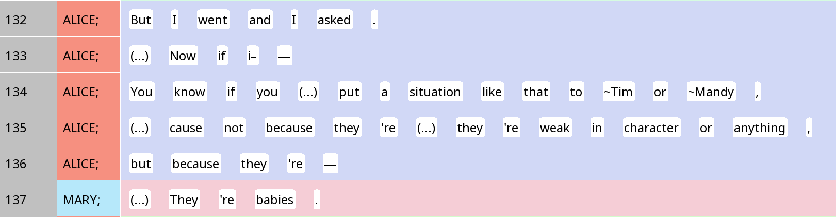

A TCU can be a clause (with subject, verb, object)

Slide 11
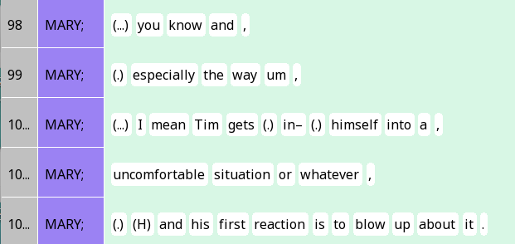
A TCU can be a gigantic, complex sentence

Slide 12
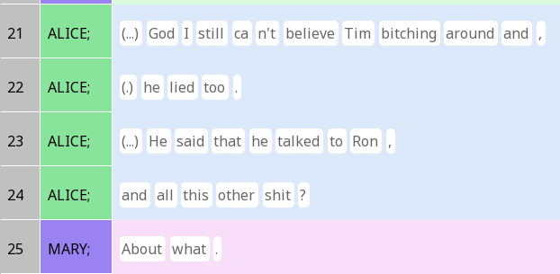
A TCU can be a phrase (here, a preposition + a noun)

Slide 13
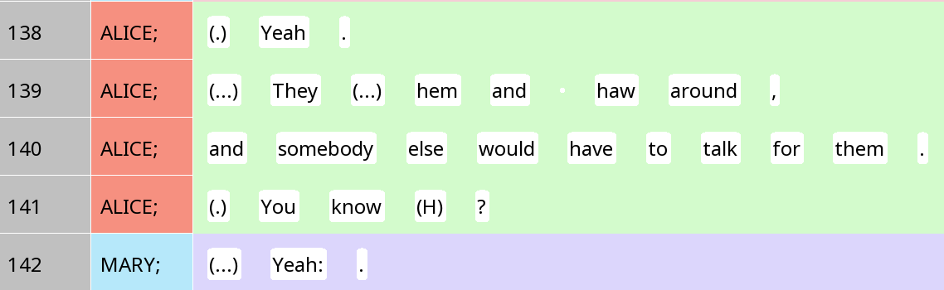
A TCU can also be small, a single word (in this case, an interjection / minimal response)

Slide 14
TCUs and turns
Typical situation: One TCU in one turn
But we often produce multi-unit turns
Situation 1: The original social action does not see immediate uptake from the other person, so we add something to it
Situation 2: We are telling a long story, giving a long description, etc.
Often we signal this in some way, e.g. using ‘well’ – projects a multi-unit turn
Often happens in SBC001!
If you hear a silence between two TCUs, and the first TCU clearly asks for someone else to respond, what situation might this be?

Slide 15
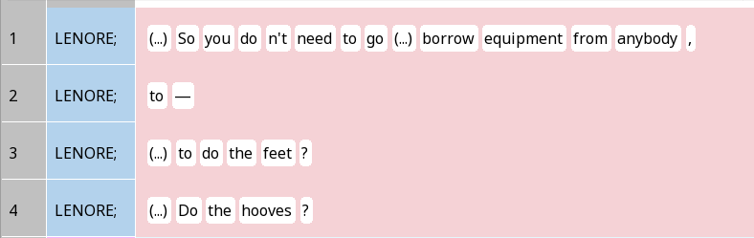
Situation 1: You didn’t get it, so I’ll try again

Slide 16
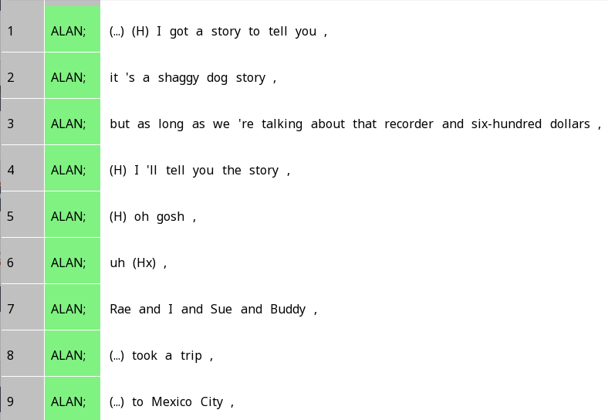
Situation 2: Projecting a multi-unit turn

Slide 17
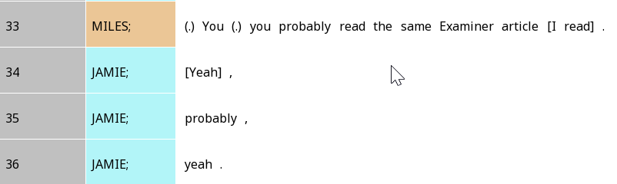
Transition-relevance places
Where a TCU can be interpreted as complete, even if it is not actually complete
We often find unintended overlap at TRPs if they don’t actually end TCUs

Slide 18
Floor-holding devices
Linguistic devices for letting the same person continue to speak
Many of them serve to say, ‘hey, the TCU is not over yet!’
Can you think of any examples?

Slide 19
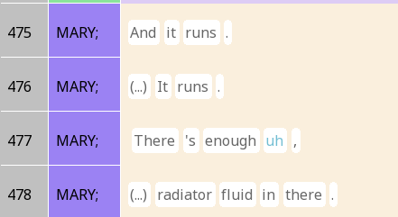
Floor-holding devices: Fillers / hesitation markers

Slide 20
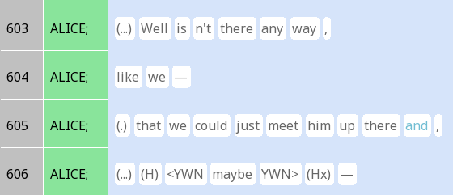
Floor-holding devices: Grammatical projection
Question: What other grammatical words can project later content?

Slide 21
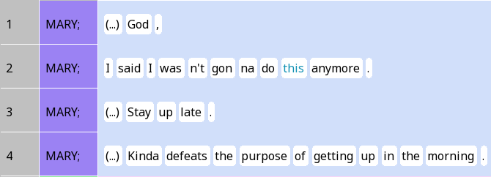
Floor-holding devices: Cataphora

Slide 22
Floor-yielding devices
Linguistic devices for letting the same person continue to speak
Many of them serve to say, ‘OK, I’m done now’
Can you think of any examples?

Slide 23
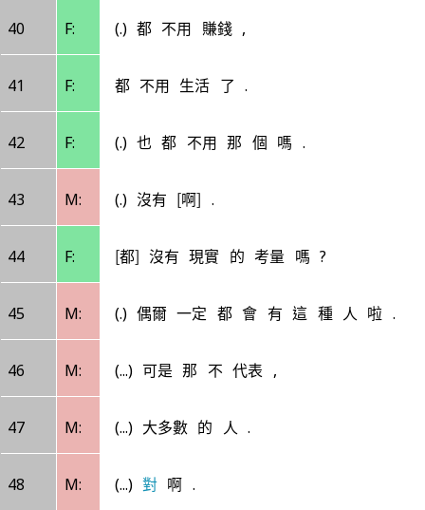
‘對’ duì in Mandarin
They don’t have to earn money at all
Don’t have to live at all
Don’t have to that kind of thing?
Hint: The pause before 對 is very long
Nah
Don’t they have real-life considerations?
There will always be this kind of person occasionally.
Question: How about in English?
But that doesn’t represent,
The majority of people.
Duì.

Slide 24
Four types of ‘endnotes’ (intonation symbols) in discourse-functional transcription
,
Continuing (‘comma’, stable)
Question: Which intonation type has a floor holding function?
?
Appeal (‘question mark’, markedly rising)
Question: Which intonation type has a floor yielding function?
.
Terminating (‘period’, markedly falling)
--
Truncation (‘dash’, prematurely ended intonation unit)

Slide 25
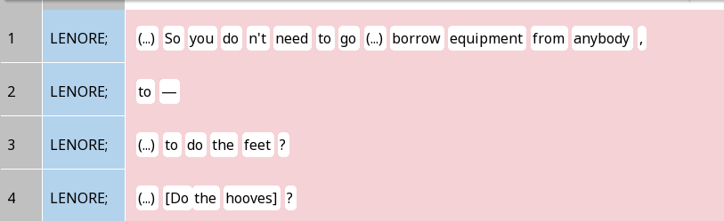
Prosody for floor holding and yielding

Slide 26
Turn allocational component
Self-selection vs other-selection

Slide 27
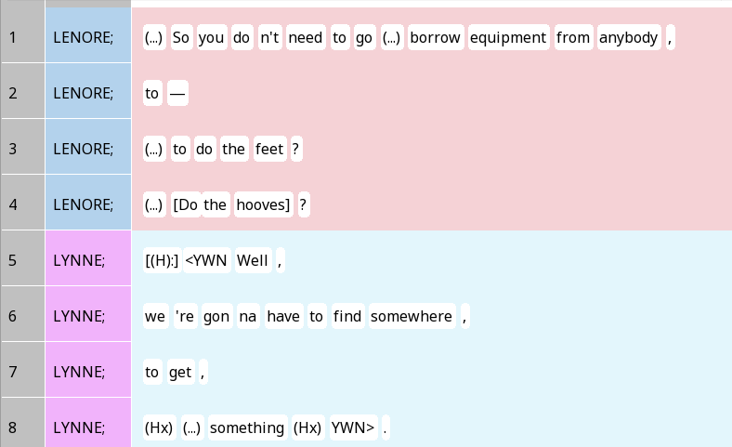
Other-selection

Slide 28
Devices for other-selection
Addressing a question to someone
Eye gaze
Other things that are ‘asking for a response’ (we’ll talk about that later in the quarter)

Slide 29
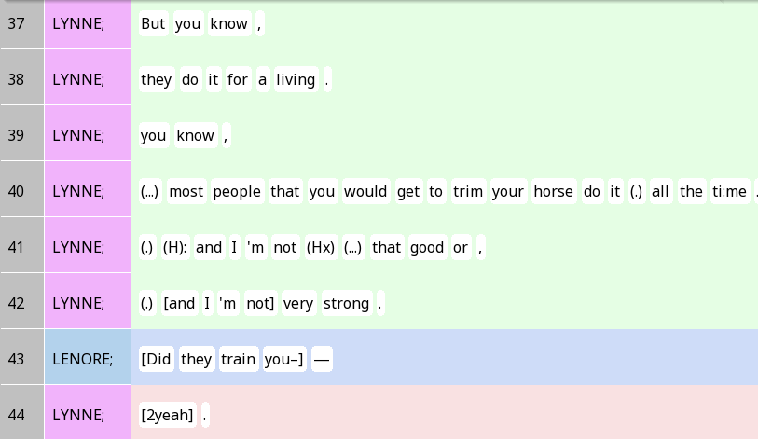
Self-selection (‘volunteering’)

Slide 30
Rule 1: At each TRP …
Is the current speaker asking someone else to speak?
Yep
Nope
(1a) That someone else should now speak
Did someone else start speaking?
Yep
Nope
(1b) The first person to start speaking gets the right to speak (i.e. first-come-first-served)
(1c) The original speaker keeps speaking

Slide 31
Rule 2 is simple.
We repeat the same thing at the next TRP.
That’s it!

Slide 32
Implications of the Simplest Systematics
It does not tell us how much each person should speak
In theory, if we keep looping through the rules, one person can keep self-selecting to continue, and produce an infinitely long turn; also in theory, we can just keep changing speakers at each TRP
It does not always tell us who needs to speak
When other-selection happens, then yeah, the selected person needs to speak
Otherwise, anything is possible, although there is a bias towards the original speaker ‘winning’ when multiple people start speaking

Slide 33
Gaps and overlaps
Classifying overlaps
Classifying silences

Slide 34
Overlaps
There are many of them especially in SBC002
Recognisable by brackets: [ ] [2 ]
Important to understand where and why overlap is happening

Slide 35
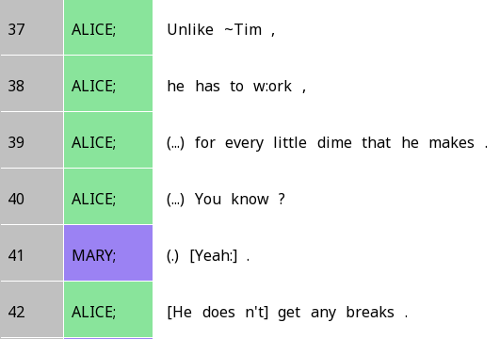
Transition-space overlap
The overlap we just saw is called transition-space overlap
Because it happened at a TRP where a new turn could potentially start
Also common with backchannels in English
Question: Does the overlap always happen exactly at a TRP?

Slide 36
Sample reasons for transition-space overlap
The TRP is not the end of the TCU
Current speaker wants to keep talking
Someone else mistakenly thinks the current speaker is done, and chimes in
The TRP ends the TCU, but the current speaker wants to produce a multi-unit turn
Current speaker wants to keep talking
Someone else mistakenly thinks the current speaker is done, and chimes in
Two people self-select at the same time
It’s not clear who the next speaker should be

Slide 37
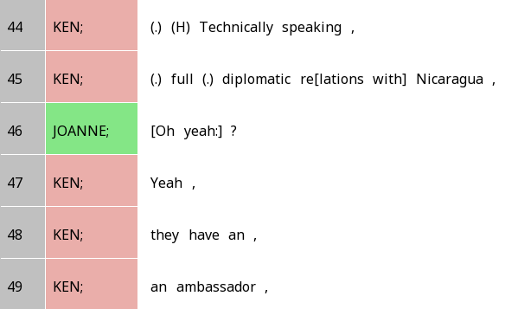
Interjacent overlap
You jump in when the other person clearly hasn’t finished
‘Diplomatic re…’ is clearly not the end of Ken’s turn
But Joanne jumps in anyway because she challenges Ken
Which of these two types of overlap is more likely to be seen as ‘impolite’ or an ‘interruption’?

Slide 38
Competitive vs non-competitive overlap
Competitive overlap: Two people are ‘fighting’ over who has the floor
Doesn’t have to be nasty or involve hard feelings
Non-competitive overlap: No fighting over who has the floor
Is interjacent overlap usually competitive or non-competitive?
When backchannel overlaps with speech, is that usually competitive or non-competitive?

Slide 39
Silences
When one person completes the turn, but no other people start speaking

Slide 40
Attributable and non-attributable silences
Attributable: In cases of other-selection, the person who’s ‘supposed’ to speak doesn’t speak
Non-attributable: Other situations where the same speaker may continue, or other speakers (not determined who) may take the turn

Slide 41
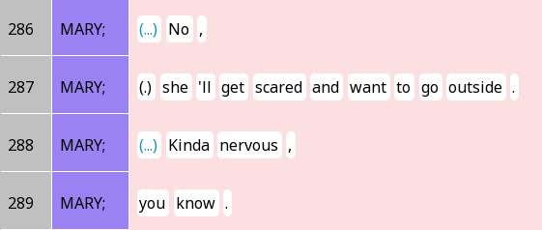
Reconstruing silences
The pause on Line 288 was very long
Mary likely intended to end the turn
But she restarted the turn with a new TCU after the silence
A between-turn silence becomes reconstrued as a turn-internal silence

Slide 42
Conclusion: Overlaps and silences
Usually, speakers see overlaps and silences as ‘problems’
And actively try to ‘fix’ them
Stop speaking once overlap occurs
Try to re-construe silences after turns as silence within a turn
These cases of overlaps and silences actually support the model
Try to find differences between SBC001 and 002 in terms of this behaviour, and examine if speakers are still orienting to the same turn-taking system!

